Slide 1

Power System for Magnetic Field Pulse Generator to Inhibit Preterm Uterine Contractions
Student: Rhitvik Kumawat
Advisor: Prof. Dariusz Czarkowski
Feb 10, 2019

Slide 2
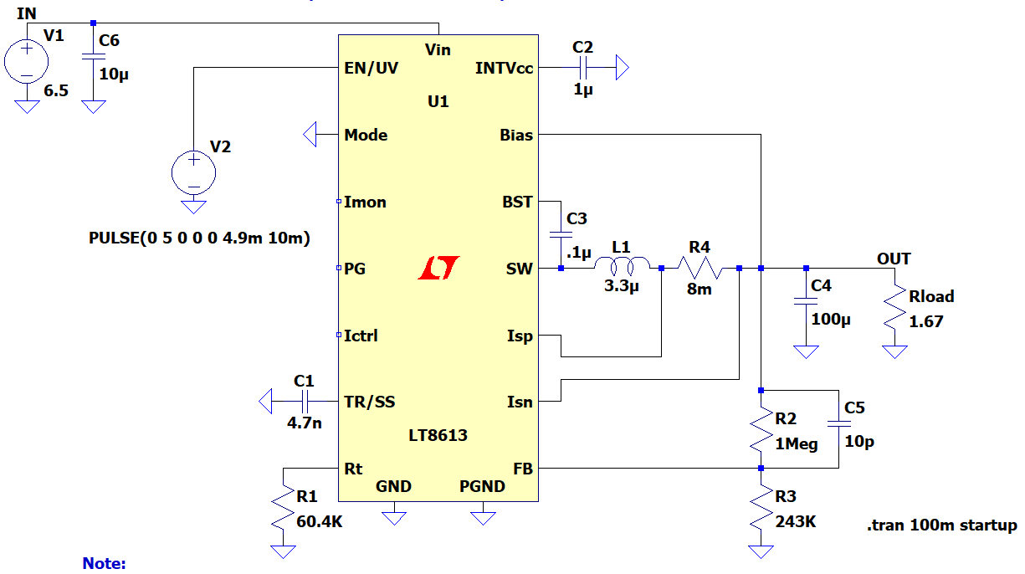
Basic Idea of Our Design
This is the IC configuration can be employed for our converter if we decide to go with LT8613

Slide 3
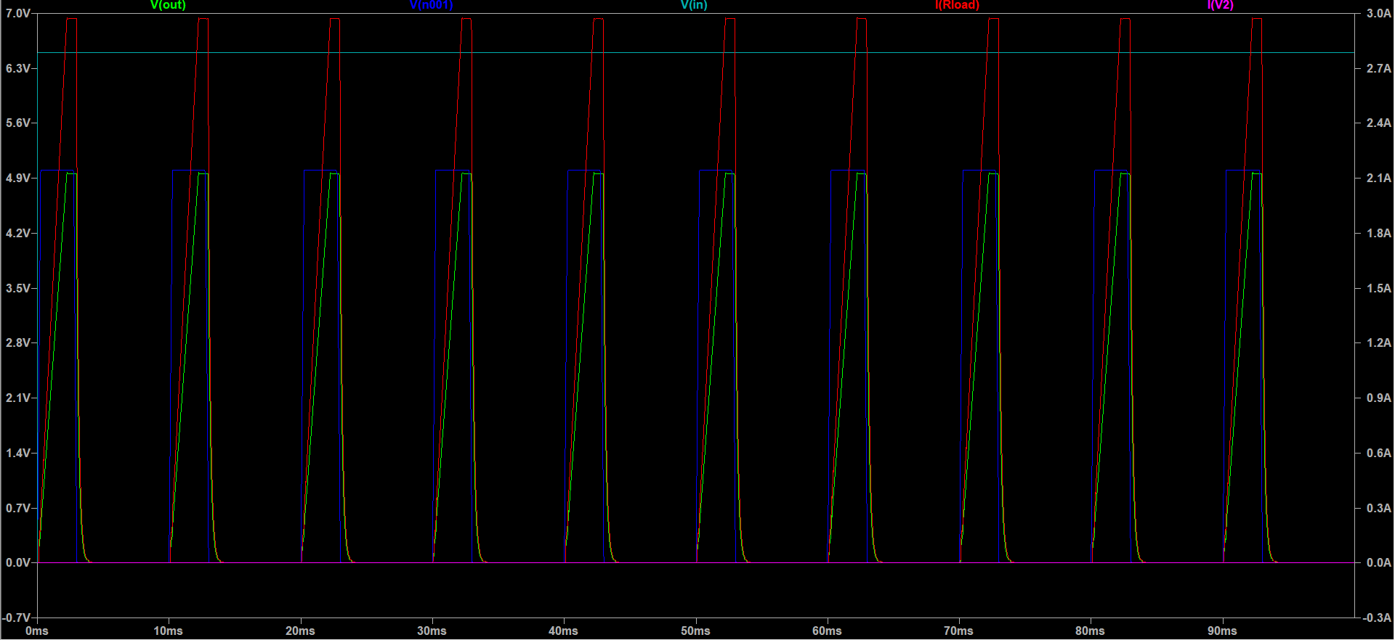
Simulation 2.5 ms pulses

Slide 4
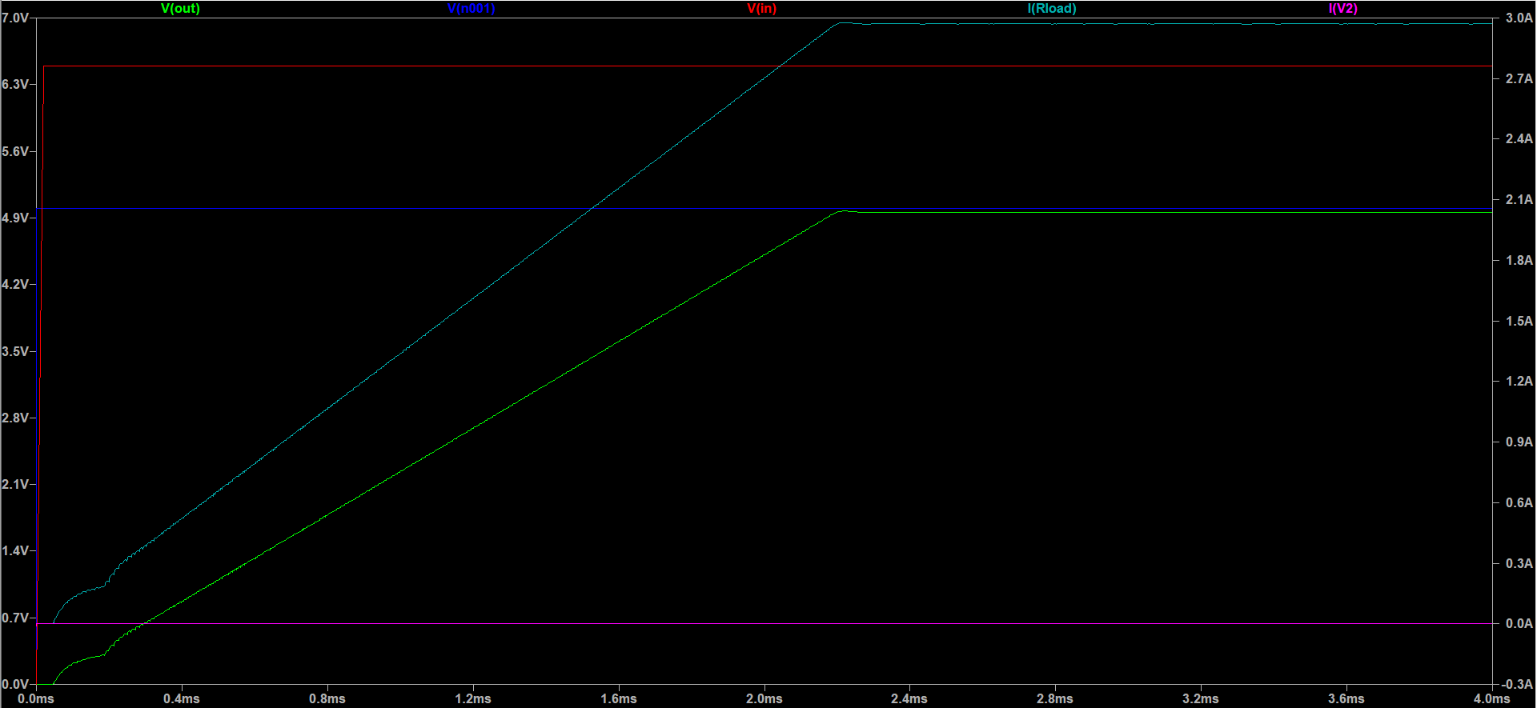
Simulation 3 ms pulse (initial response)

Slide 5
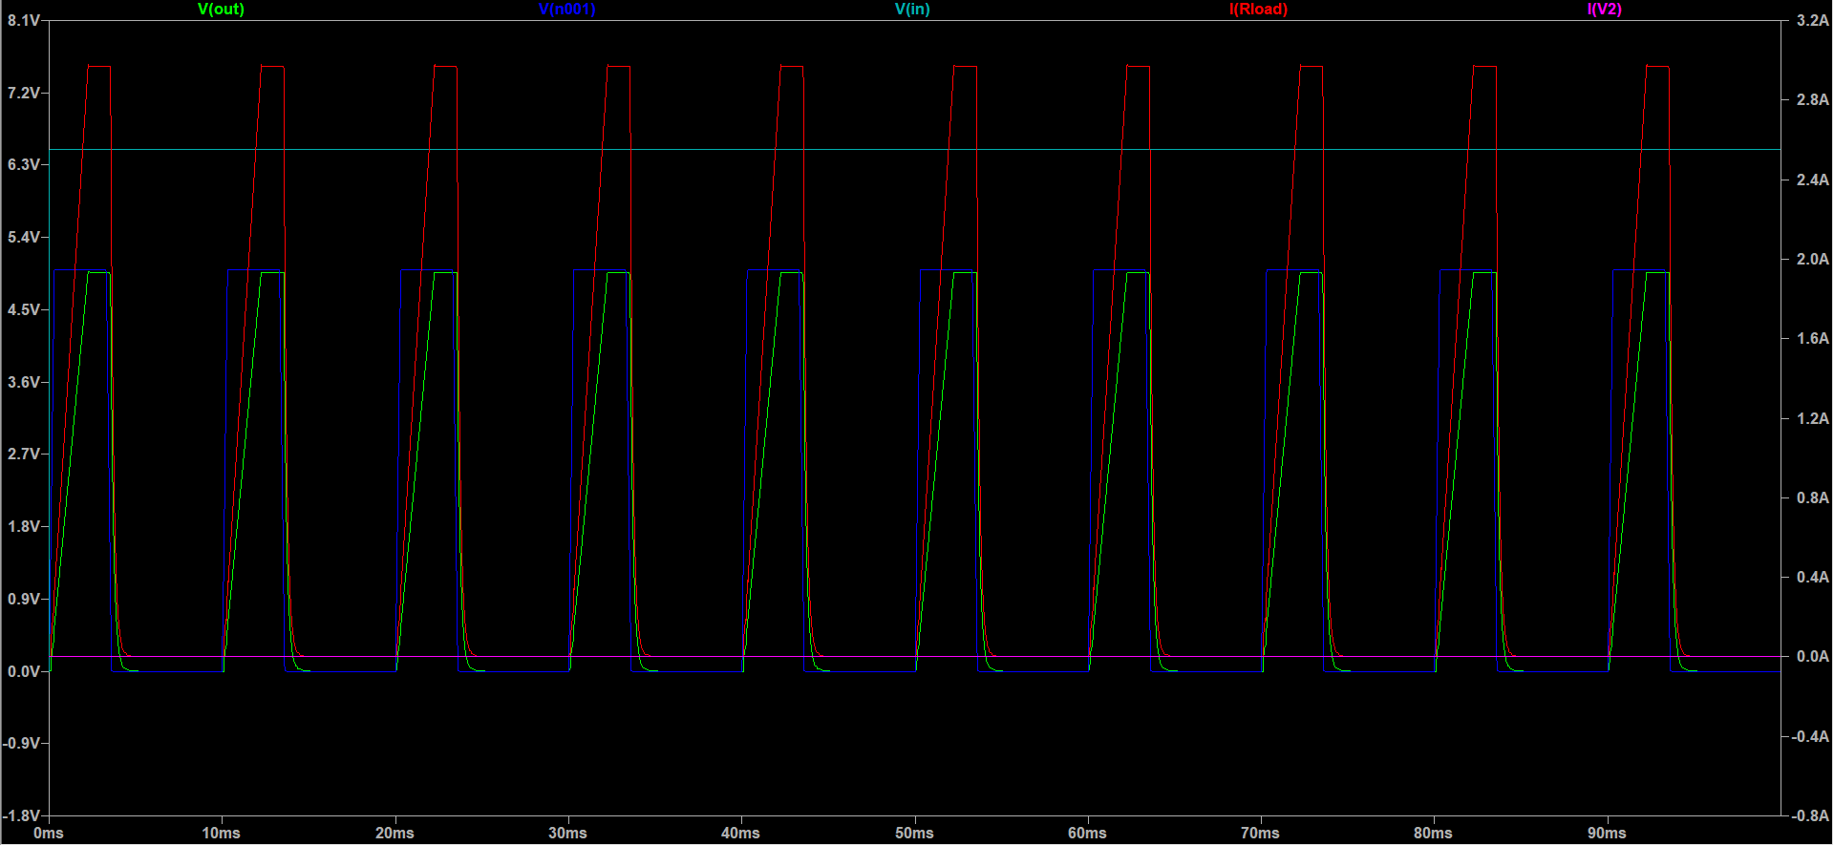
Simulation 3 ms pulses

Slide 6
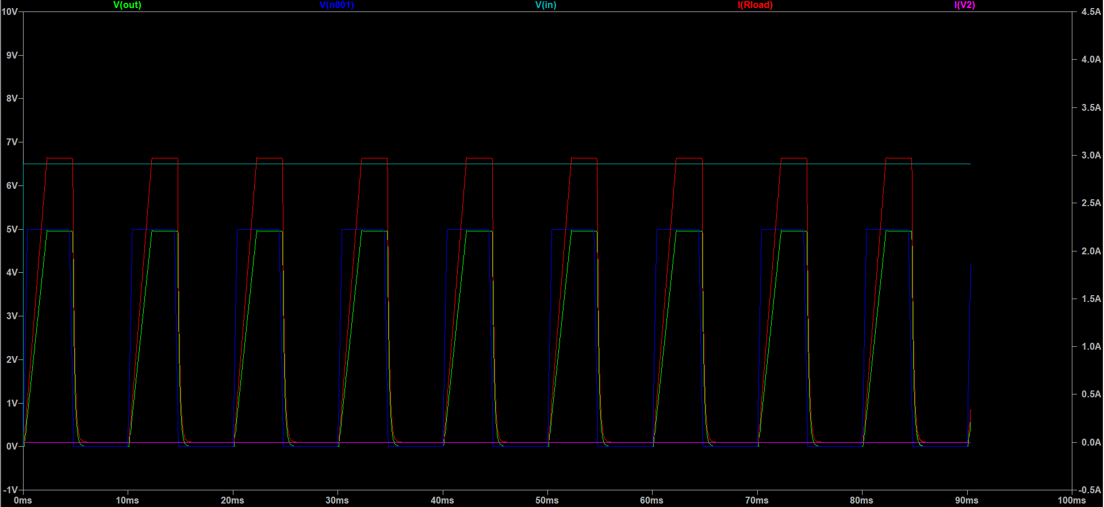
Simulation 4 ms pulses

Slide 7
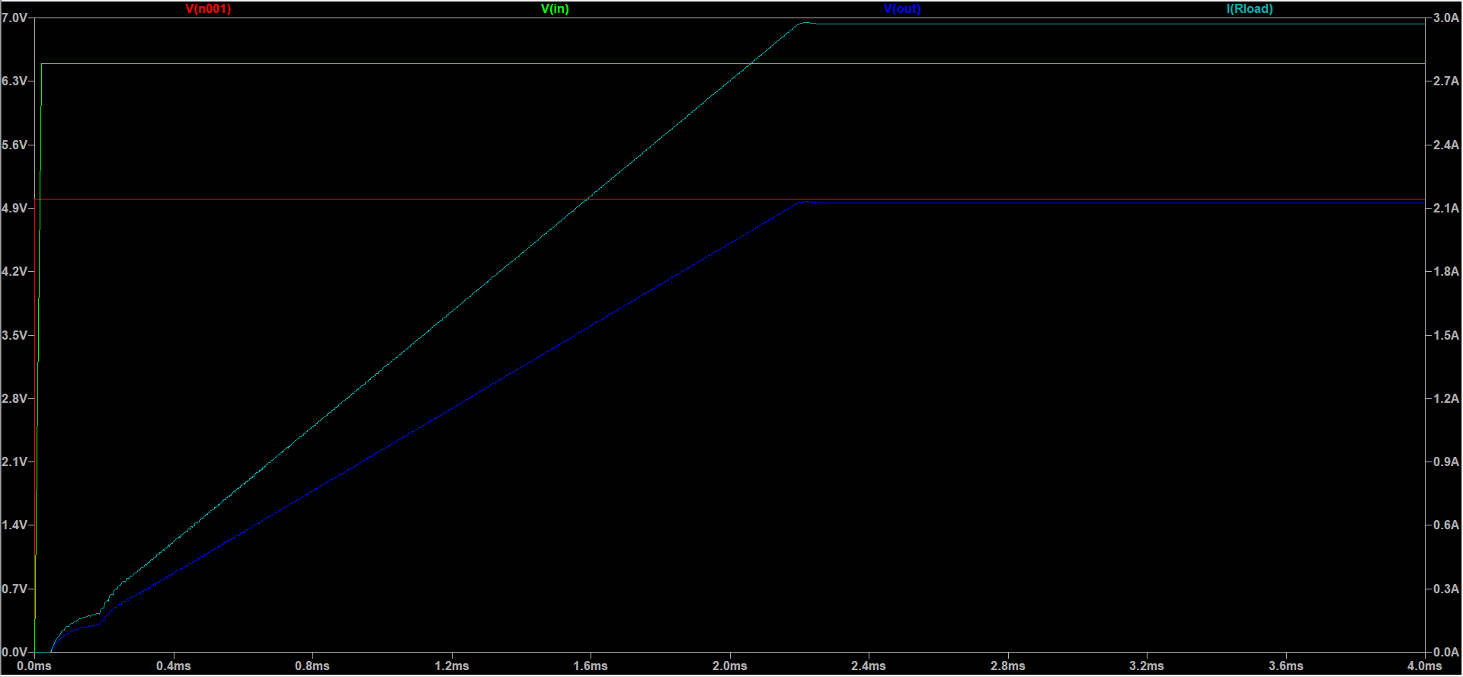
Simulation 4.9 ms pulse

Slide 8
End of Presentation
Thank you

